Slide 1
Lesson 1 – Quantifiers
Module 2 – Grammar Study 2

Slide 2
Definitions
A quantifier is a word (or phrase) which indicates the number or amount being referred to. It generally comes before the nouns (or noun phrase).
Quantifiers: much,many, some,any, a few,a little, a lot of, lots of.

Slide 3

Much and Many
Forms
EX: There are not many students in the class.
EX: How many students are there?
EX: There is not much water in the cup.
EX: How much water is there?

Slide 4

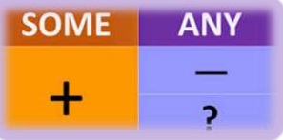
2. Some and Any Ex: I need some coffee. Ex: I don’t need any coffee. Ex: Can I have some pens please? Ex: Do you need some coffee? Ex: Would you like some fresh water? Ex: Does she have any books?

Slide 5
3. A few and a little Ex: A few friends of mine will visit the museum. Ex: A few students are not assigned to do the homework. Ex: There is a little water in the cup. Ex: Can you give me a little sugar?

Slide 6

3. A lot of/ Lots of Ex: There are a lot of students in the class. Ex: Are there lots of visitors at the museum? Ex: I don’t have a lot of bread. Ex: There is not lots of sugar in the pot.

Slide 7





Thank you !
www.passerellesnumeriques.org

